Slide 1
Question of the day!
What is your favourite board game…?

Slide 2


Slide 3
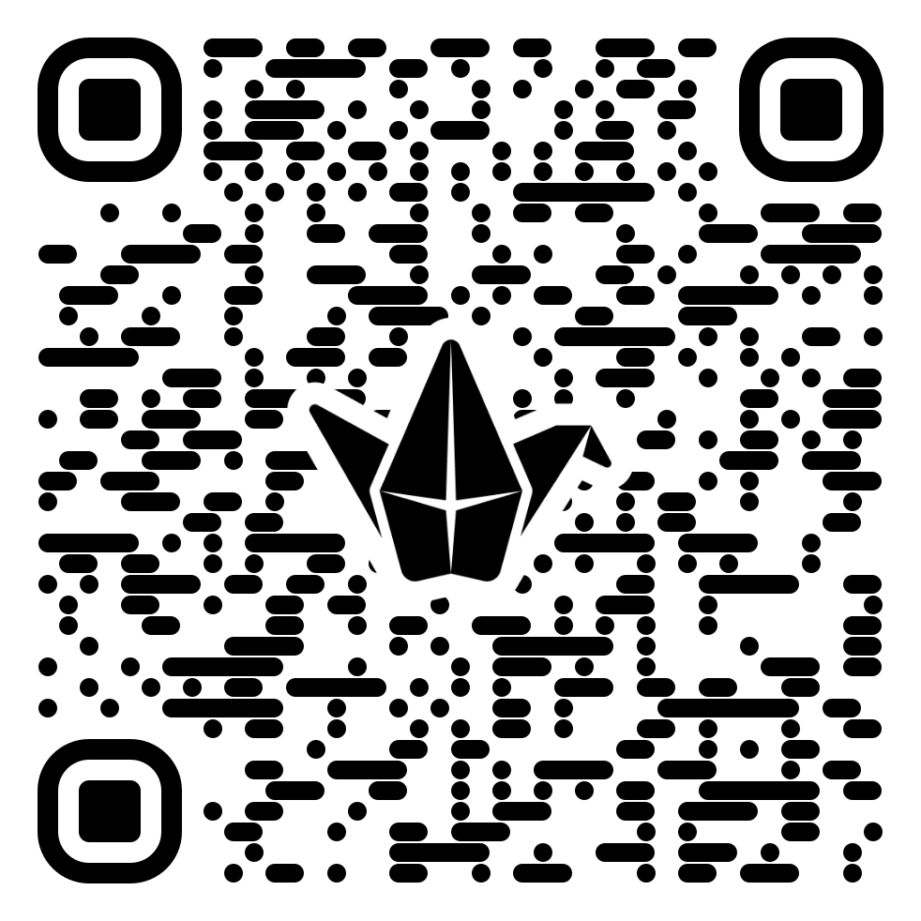

CMP2804 Team Software Engineering
https://lncn.ac/CMP2804
Week 1

Slide 4

Module Introduction
Staff, lecture sessions, supervisors
Module Assessment
Peer assessment
Assessment requirements
Working in a Team
Sprints

Slide 5
Module Details

Slide 6
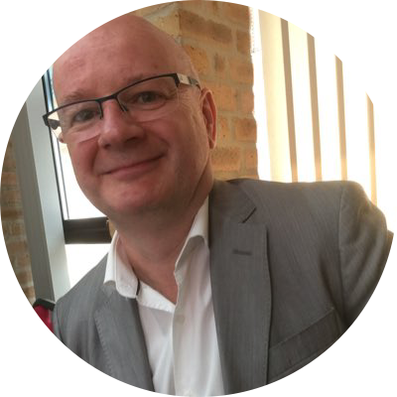

Dr Mark Doughty
Weeks 1, 2, 6, 8, 9
Weeks 3, 4, 5
Throughout Semester A and B:
Meet regularly with your project supervisors!

Slide 7
There are two assessments:
[GROUP] Team Project Proposal (Semester A, Week X [xx/xx/xx], 35%)
+ [INDIVIDUAL] Blackboard Journal Sprint Review entries (x2)
[GROUP] Team Project Poster and Artefact (Semester B, Week X [xx/xx/xx], 65%)
+ [INDIVIDUAL] Blackboard Journal Sprint Review entries (x3)

Slide 8
Peer assessment
Each team member will complete an anonymous basic assessment of other team members.
So final mark for each assessment reflects individual contribution as well as an overall mark.

Slide 9
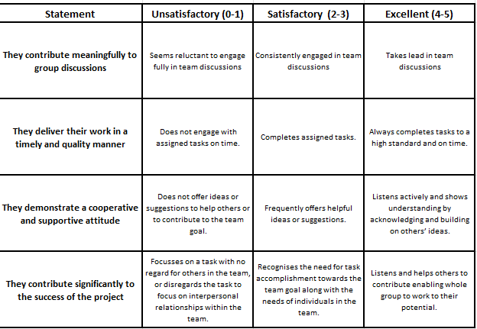
Mark each team member out of 5 for these criteria:

Slide 10



Assessment 1
Proposal Document
[All team members collaborate]
Blackboard Journal Sprint Reviews
[Individual]
Anonymous Peer Assessment
[Individual]

Slide 11
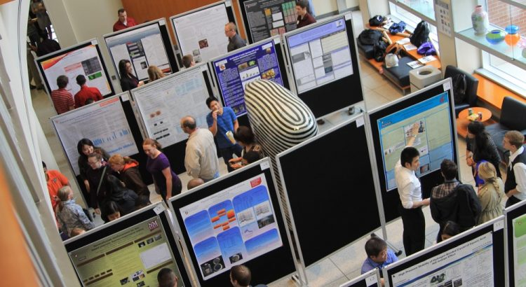
Assessment 2
Project Poster + Artefact
[All team members collaborate]
Blackboard Journal Sprint Reviews
[Individual]
Anonymous Peer Assessment
[Individual]

Slide 12

Work in a team to develop software

Slide 13
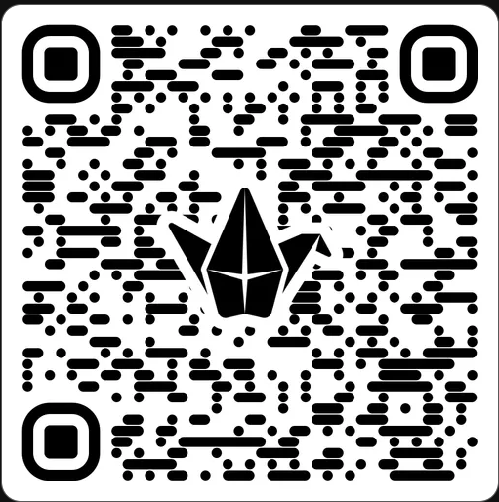
What are the benefits and possible issues when working in a team?

Slide 14

Each team member will be required to sign a ‘contract’.
Regular team meetings with academic guide/supervisor.
Individual contributions are calculated from the Peer Assessments.
A ‘Grade Calculator’ will work out your final grade from the peer assessment and the overall mark for the assessment.
If there is a disagreement among the team, the ‘Dispute Resolution Process’ will need to be followed.

Slide 15
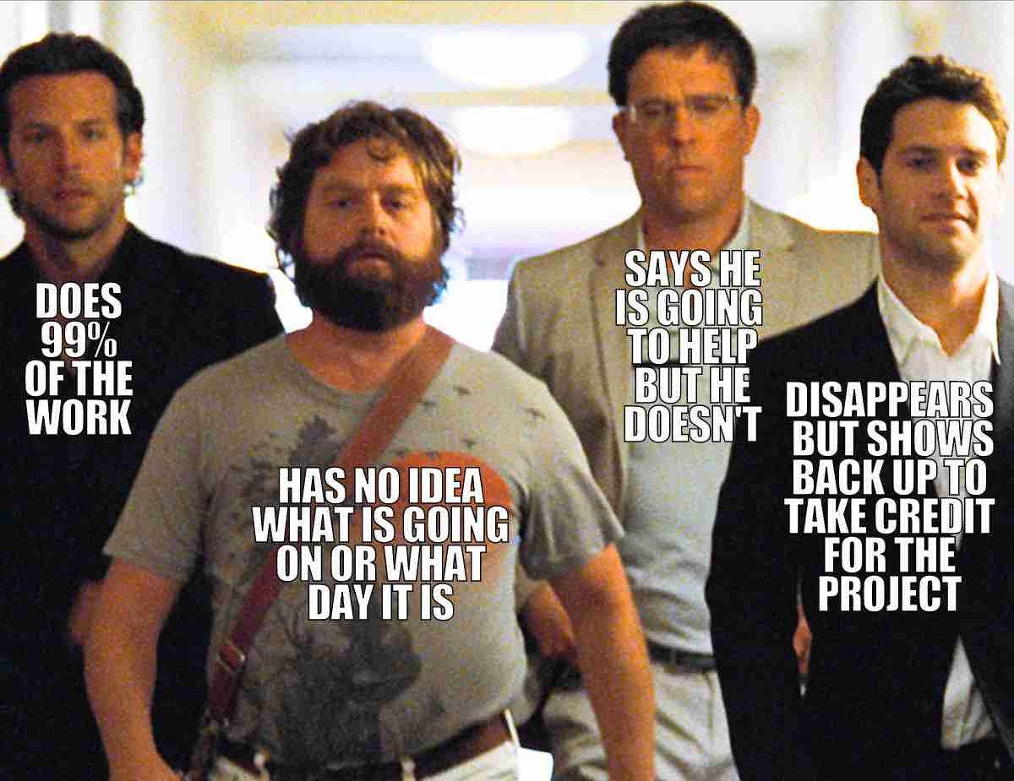

Slide 16
What are ‘sprints’?
A sprint is a short, time-boxed period when a team works to complete a set amount of work.
At the end of every sprint, you can review the progress on the sprint tasks and problems faced.
Sprints are at the very heart of scrum and agile methodologies, and getting sprints right will help your agile team ship better software with fewer problems.

Slide 17
What are ‘sprints’?
Sprint 0: (Sem A ~week 2) Deliverables: setting up the team, initial project ideas and team meeting.
Sprint 1: (Sem A ~week 6) Deliverables: project proposal, project requirements, proposal documentation.
Sprint 2: (Sem B ~week 10-12) Deliverables: formative MVP (Minimum Viable Product)
Sprint 3: (Sem B ~week 24) Deliverables: formative Artefact
Sprint 4: (Sem B ~week 30) Assessment Deliverables: Artefact, Documentation, Poster

Slide 18

Do one thing – no matter how small – towards your assessments each day.
Helps keep you motivated – what did you do today?
Have a look at https://www.youtube.com/watch?v=bxtv5XB7eIA
Or even https://www.reddit.com/r/NonZeroDay/

Slide 19
Summary
Module Introduction
Staff, lecture sessions, supervisors
Module Assessment
Peer assessment
Assessment requirements
Working in a Team
Sprints

